Slide 1
ADO Pipelines: Improving your current solution thru automation.

Slide 2

Why use ADO Pipelines
Foundation for ensuring:
Quality products are delivered
Frequent delivery (same day deployment)
CI/CD
What it provides you:
Reduce lead time
Reduce manual intervention
Reduce dependency on your 1 "build" person
Repeatable (providing consistency)
Modern branching strategy
Code review checkpoint
Build your solution
Execution of your tests (unit, functional, security, accessibility, perf, end to end...)
Manage secrets
Deploy your solution to environments
What about Java? Same Concepts different tools
Jenkins, Maven, Artifactory...
Cloud vs On-Premise

Slide 3
Demo
Done with ADO on premise
Using AEHRS-SARRE application
Will show
How to create a build pipeline
How to configure the release pipeline to different verticals
How to setup multiple pipelines for targeting different tests and environments

Slide 4
Demo : Build Pipelines
1st Build Pipeline for code validation purpose
Use in Pull Request (as policy)
Regression tests on each code push
Instant feedback
2nd Build Pipeline for build artifact purpose
Repeat same step as for the 1st one
Prepare the build artifact
Publish the build artifact to the drop repository

Slide 5
Demo : Release Pipeline
Fetch the build from the artifact repository (Drop)
Define stages (Integration, SysTest, Uat, Pre-Prod, Prod)
Prepare secrets variables for injection
For each stages
Prepare the build
Inject secrets in configuration (using ADO Library)
Deploy the build
Do more depending on the stage

Slide 6
Annexe
SADE documentation https://architecture/sade-edap/admin/Wiki/Build%20Definition%20Setup.aspx

Slide 7
Automation of your process
Modern development requires automation as much as possible.
Usage of modern branching strategy
Automation of code scans
Automation of testing
Unit/Integration/E2e/Performance/etc tests
Automation of the build/release

Slide 8
AEHRS-SARRE initiative approach
Build the application using CI/CD and DevOps in mind
TDD (Unit Tests, Integration Tests, E2e Tests)
Agile Methodology
Pipeline
Git Branching Strategy
Code Review
Automated scan tools
Build it with cloud in mind.
Collaboration first
Using Cloud first technology (.NET core, SQL Server, ADO, Entity Framework)
Reduce tech debt.

Slide 9
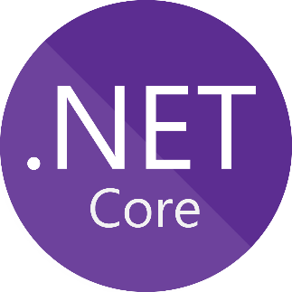
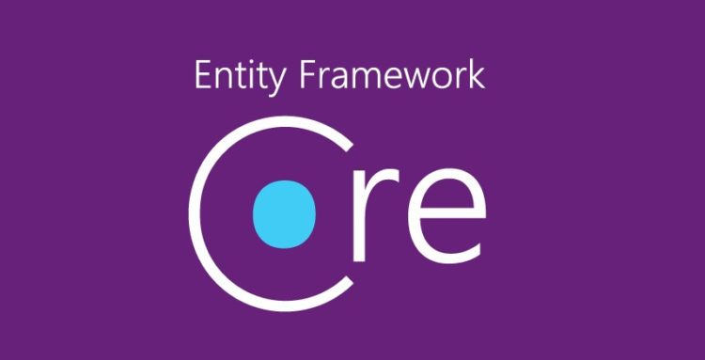
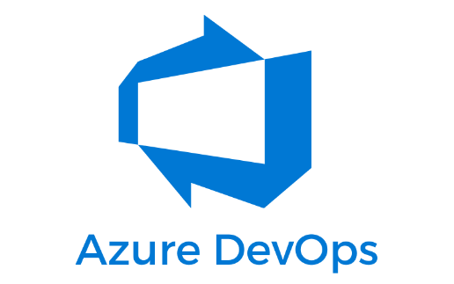
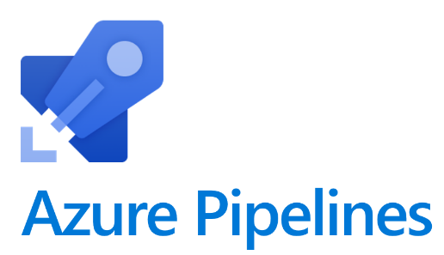

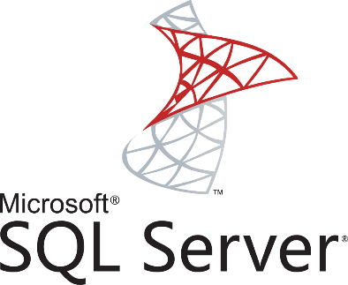
Our approach (suite)
Using new technologies

Slide 10
Our approach (suite 2)
Rewrite using .NET core MVC
Compatible with Docker (if we move to cloud)
Standard N-Tier Enterprise Architecture
Use Entity Framework Core as Data Layer
Improve productivity
Easier to integrate with Automated Tests (inMemory Database)
Data Access code follow the Git branching strategy
Take the opportunity for the team to apply best practices.

Slide 11
Why SQL Server?
Better integration with .NET core stack.
Compatibility with tools.
Simpler and easier to use.
More alignment with Cloud services. (MSSQL as a service)
Possibility to use Local DB instances which align with Git Branching strategy. (DB follow the source code)

Slide 12
Entity Framework & Security
Using LINQ query prevents malicious SQL injection risks.
Application account only have CRUD rights. It doesn’t have DBA roles.
Recommended by OWASP
Microsoft best practices https://docs.microsoft.com/en-us/dotnet/framework/data/adonet/ef/security-considerations

